Slide 1
CITY CONNECT CAR LOAN PROCESSING SYSTEMS

Slide 2


CONTENTS
INTRODUCTION
REQUIREMENT ANALYSIS
FLOW DIAGRAMS
PHASES

Slide 3
INTRODUCTION

Slide 4
The tasks involve loading applicant and car loan details into the bank's database, updating repayment details from collection agencies and CITY CONNECT Bank, and generating daily and weekly reports on car loan repayments. Additionally, there is a task for cleaning up and loading applicant, car loan, and payment data into the history database.

Slide 5
REQUIREMENT ANALYSIS

Slide 6
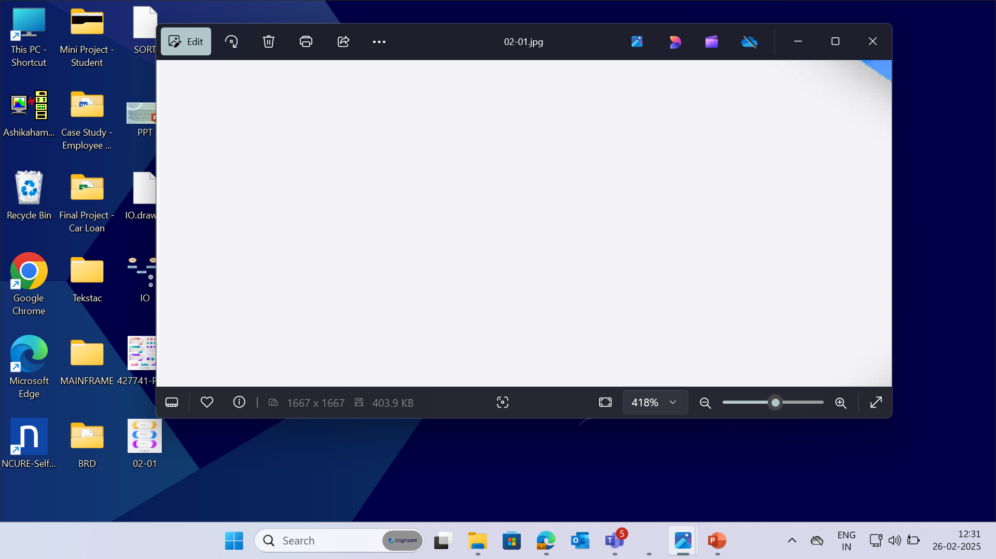


PCOMM Emulator - to access the Mainframe environment.
Pcom Emulator
SOFTWARE
REQUIREMENTS
DB2 - used for storing
the data in format.
TSO, JCL – to run and execute programs.
COBOL – to access inputs and perform required computations.
6
© 2025–2027 Cognizant | Private

Slide 7
CONTEXT FLOW DIAGRAM

Slide 8
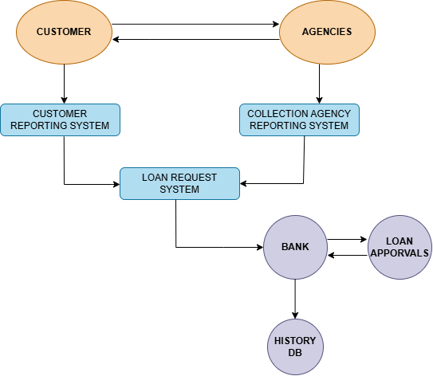
The context flow diagram shows loading applicant and car loan details, updating repayment information, generating repayment reports and cleaning/loading data into the history database.

Slide 9
DATA FLOW DIAGRAM

Slide 10
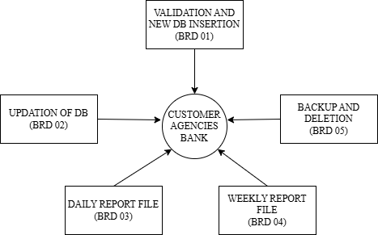
The Data Flow Diagram (DFD) visually represents the flow of data within a system, illustrating how data is processed.

Slide 11
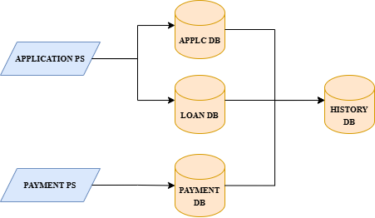
The below Flow Diagram depicts the overall process done in Car Loan Processing systems.

Slide 12
BUSINESS REQUIREMENT OVERIEW

Slide 13
BRD 03 - REESHMA K R
(2372574)

Slide 14
BRD : 03 - Daily Report of Missed Repayments
The process involves verifying if payments posted into the payment table cross the next repayment due date, calculating penalty fees for delayed payments, and generating a daily report in CSV format. It then involves sorting records by loan type, applicant ID, and loan ID, backing up the sorted report in a GDG file, and updating the Master Loan VSAM KSDS file with new payment details. Finally, it includes generating a report for applicants with monthly repayment amounts between 1000 and 2000 in the standard format with page breaks.

Slide 15
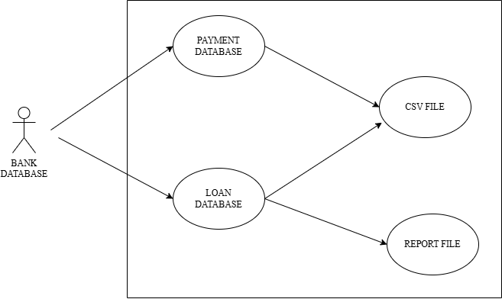
BRD : 03 – Use Case Diagram

Slide 16
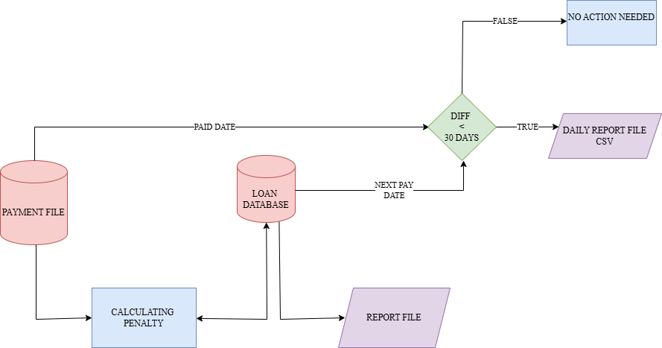
BRD : 03 – Flow Chart

Slide 17
PROCESS FLOW
Verifying Payment Dates
For each payment made, the payment date is compared to the next repayment due date. If the payment is late by less than 30 days, it is reported in a daily CSV report that includes detailed applicant and loan information.
2. Calculating Penalty Fees
Penalty fees for delayed payments are calculated based on the number of days late and the loan tenure type. Penalties vary and are applied as a percentage of the monthly repayment amount.
3. Sorting and Backing Up Records
Payment records are sorted by loan type, applicant ID, and loan ID using the SORT utility. The sorted report is then backed up in a GDG file with a limit of 12 versions, ensuring data integrity.

Slide 18
4. Updating Master Loan File
Newly added payment details are included in the Master Loan VSAM KSDS file. This keeps the master file updated with the latest payment information for all loans.
5. Generating Specific Reports
Applicants with monthly repayment amounts between 1000 and 2000 are identified, and separate report files are generated in the standard format with a maximum of 8 lines per page. This ensures comprehensive and organized reporting.

Slide 19
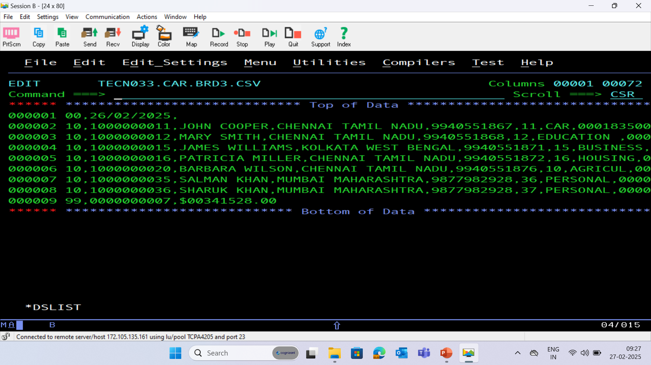
BRD 03 CSV (COMMA SEPERATED VALUES) FILE

Slide 20
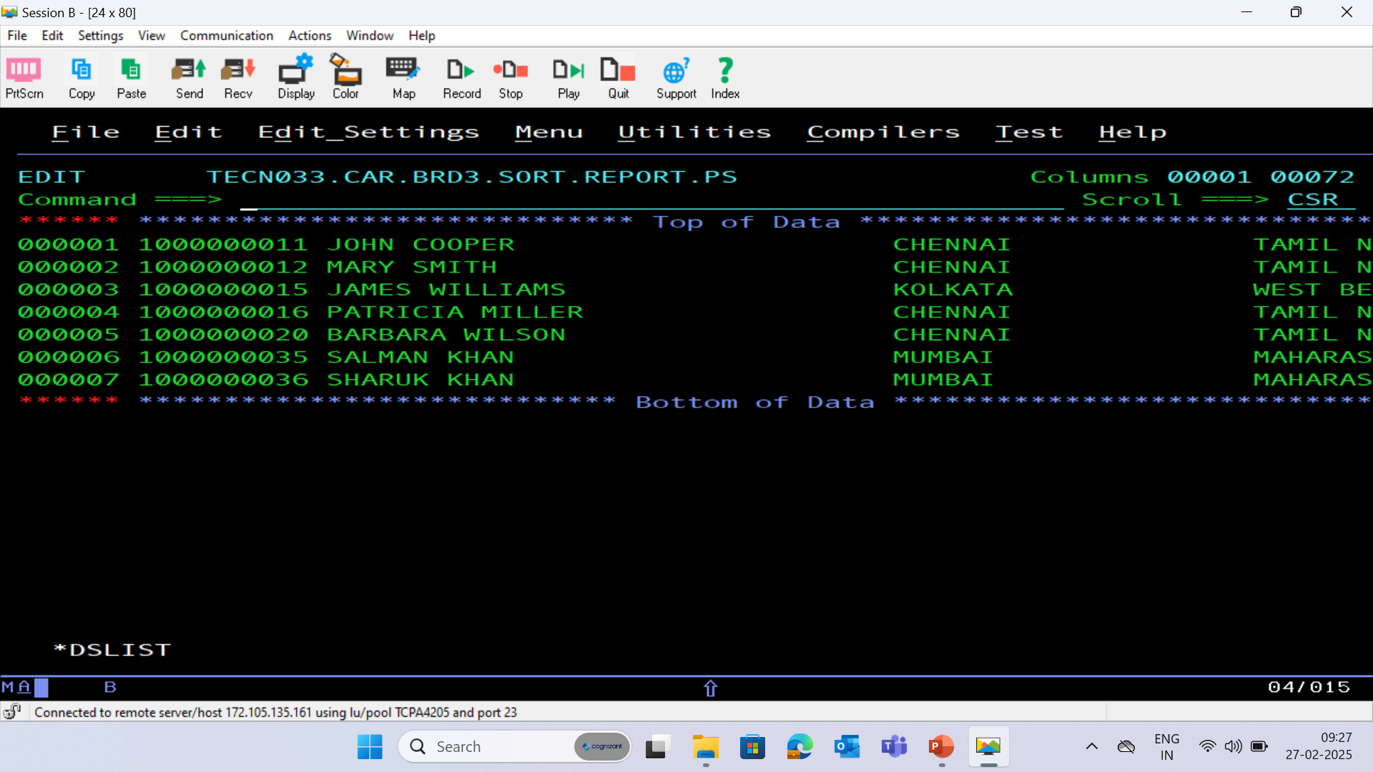
BRD 03 REPORT SORT FILE

Slide 21
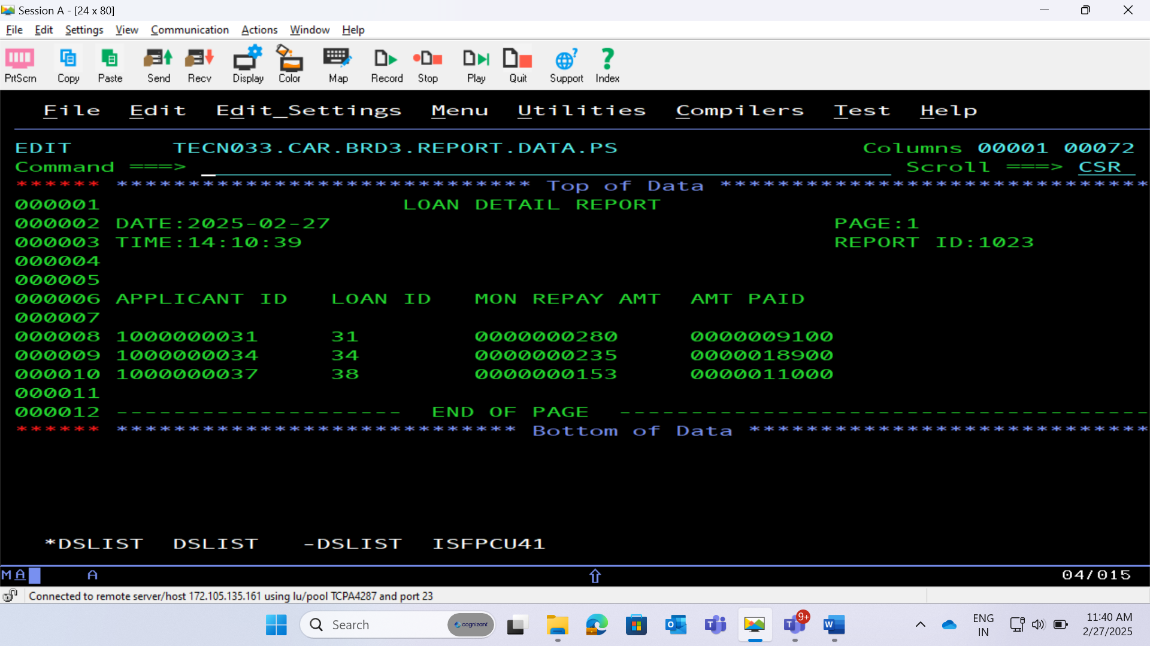
BRD 03 REPORT PS FILE

Slide 22
THANK YOU

Slide 23
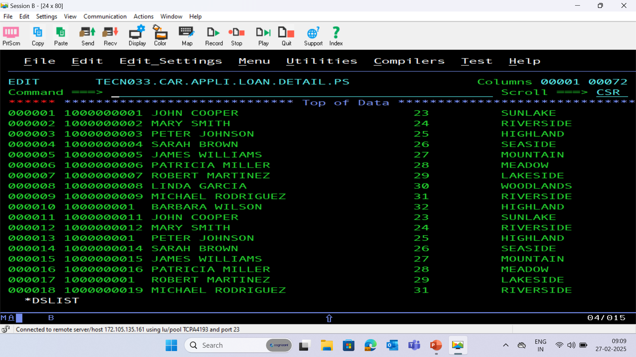
APPLICATION PS FILE

Slide 24
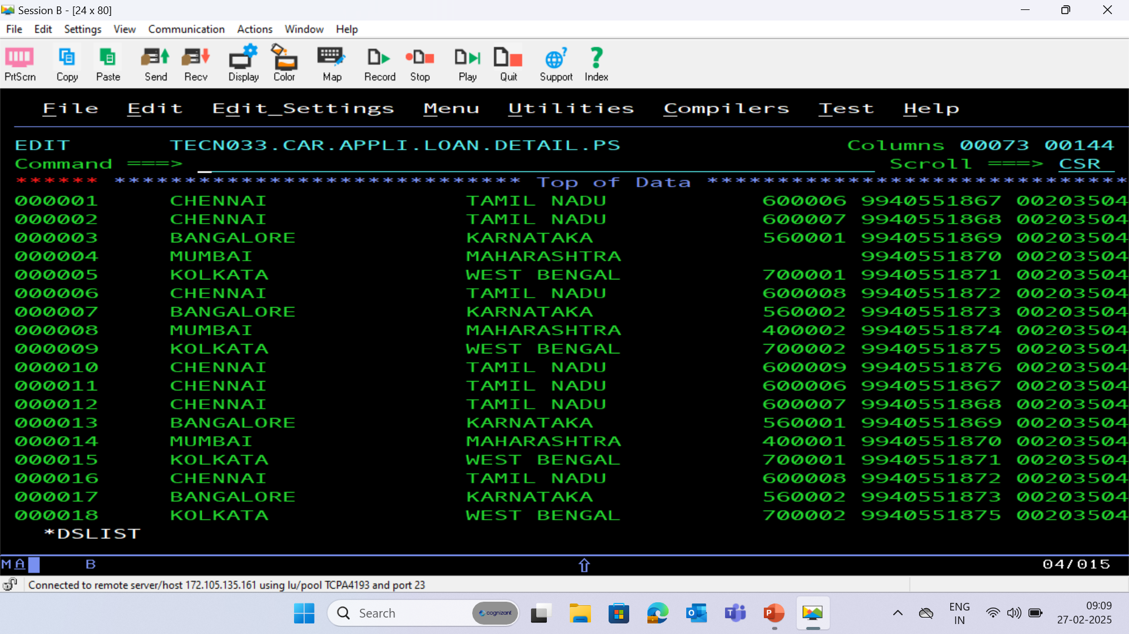

Slide 25
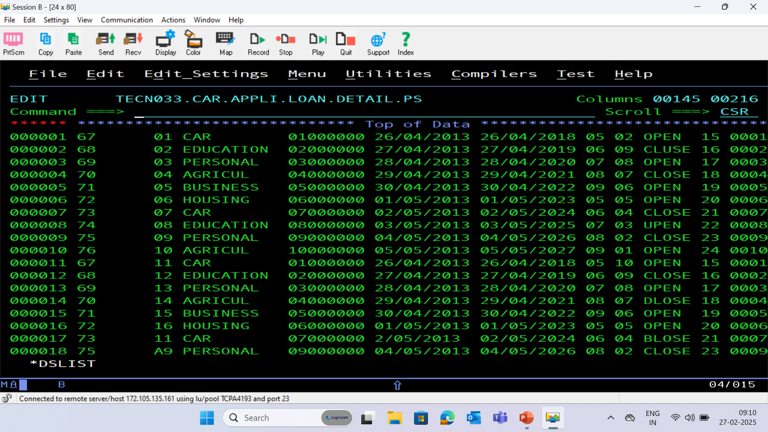

Slide 26
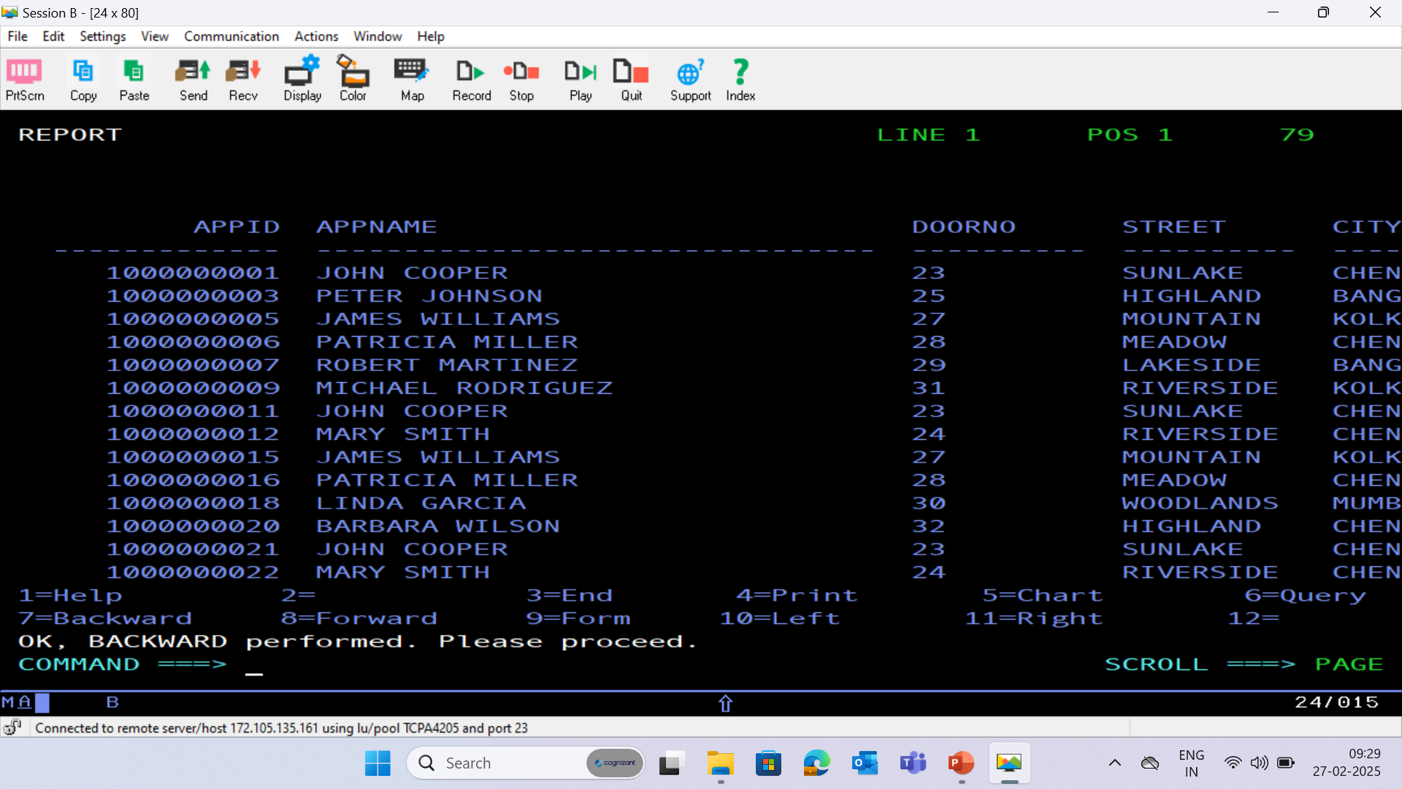
APPLICATION DATABASE - (APPLC)

Slide 27
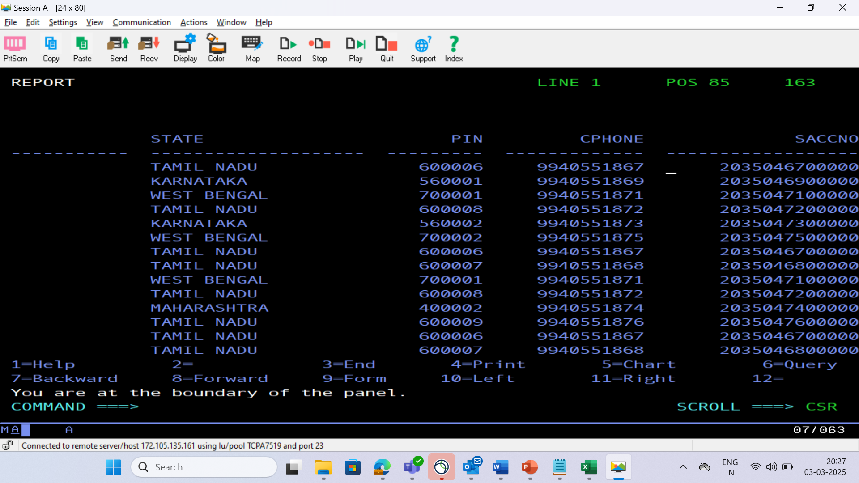

Slide 28
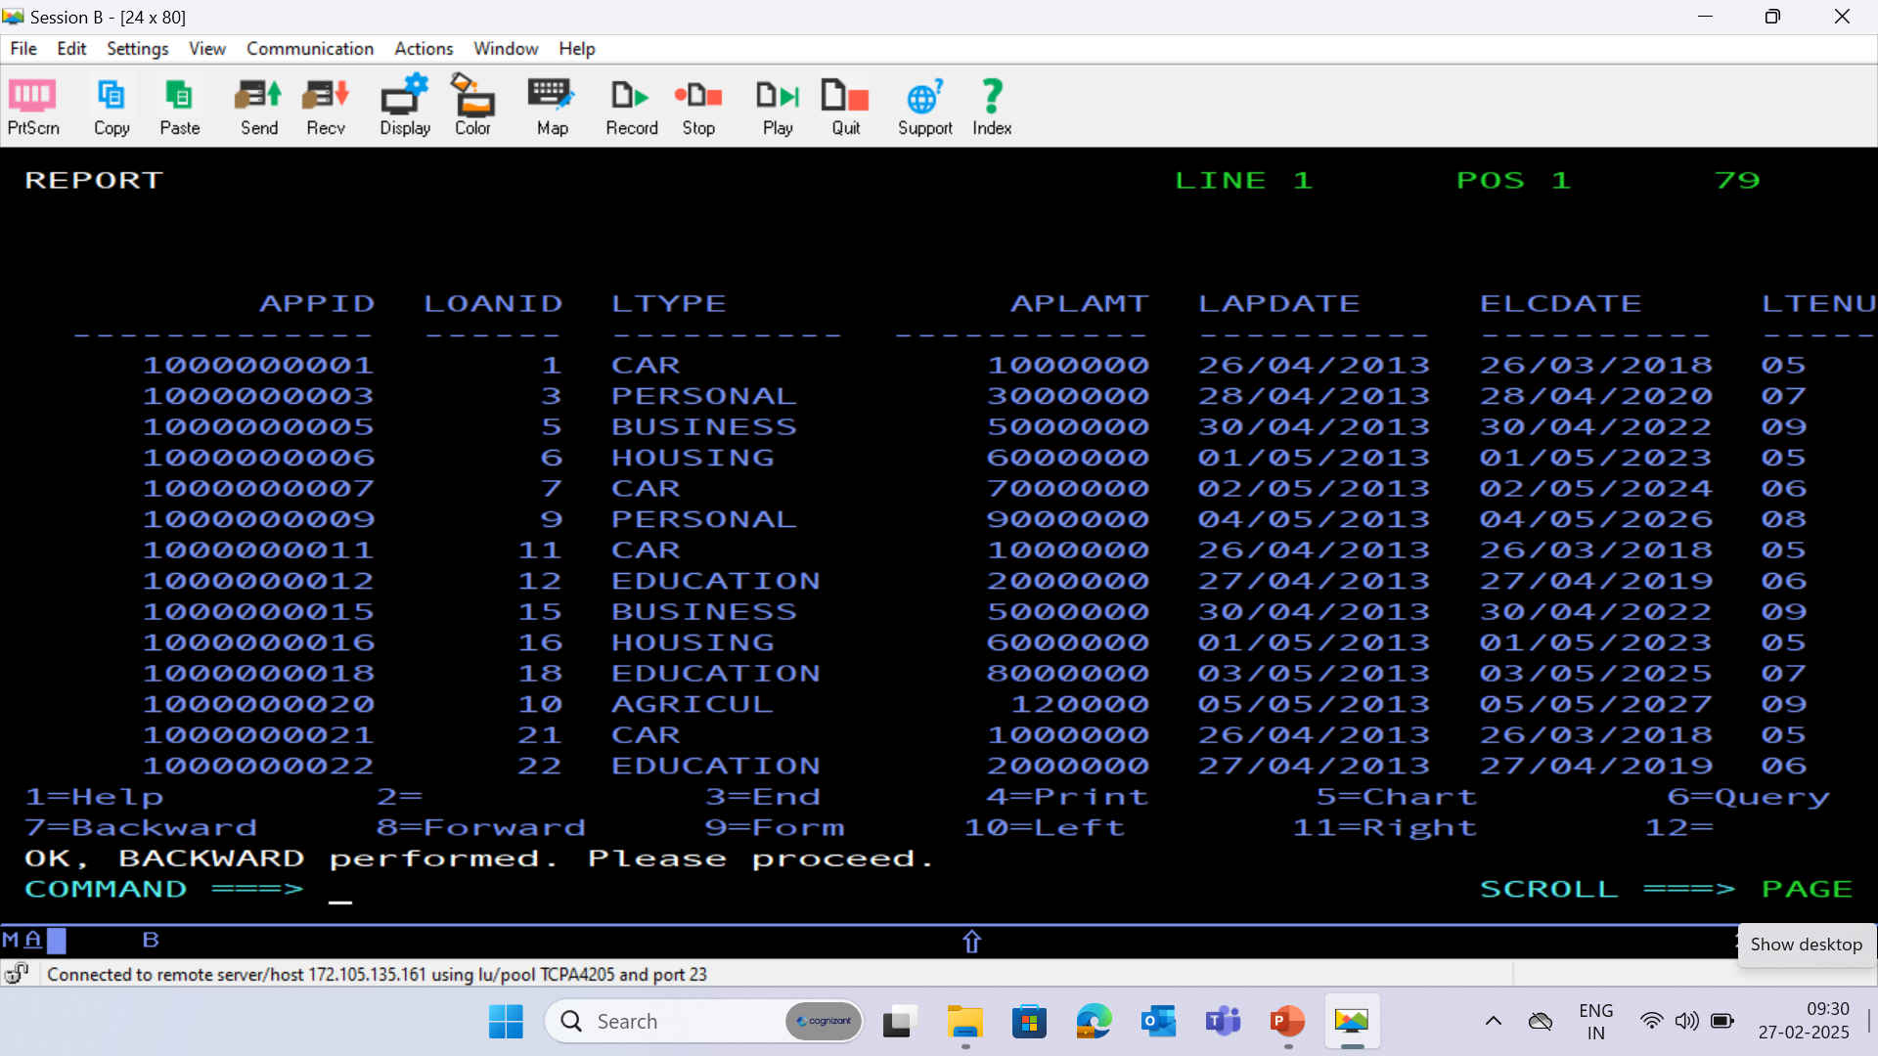
LOAN DATABASE - (LOAN)

Slide 29
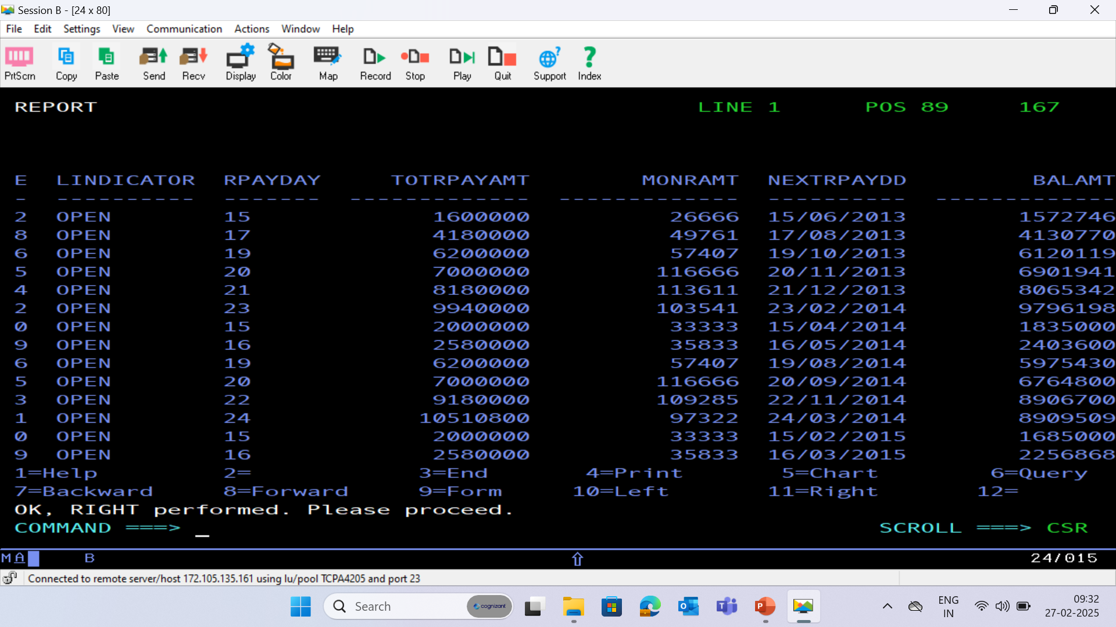

Slide 30
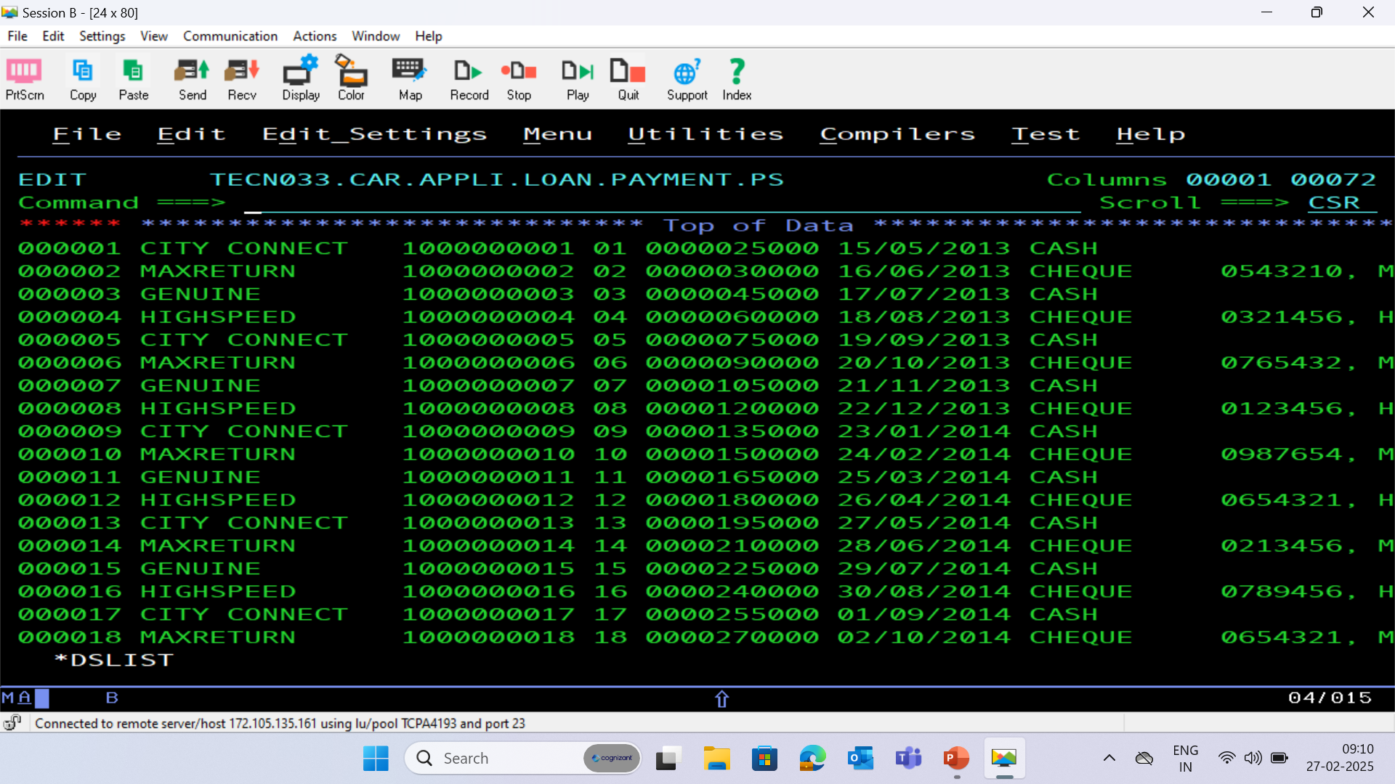
PAYMENT PS FILE

Slide 31
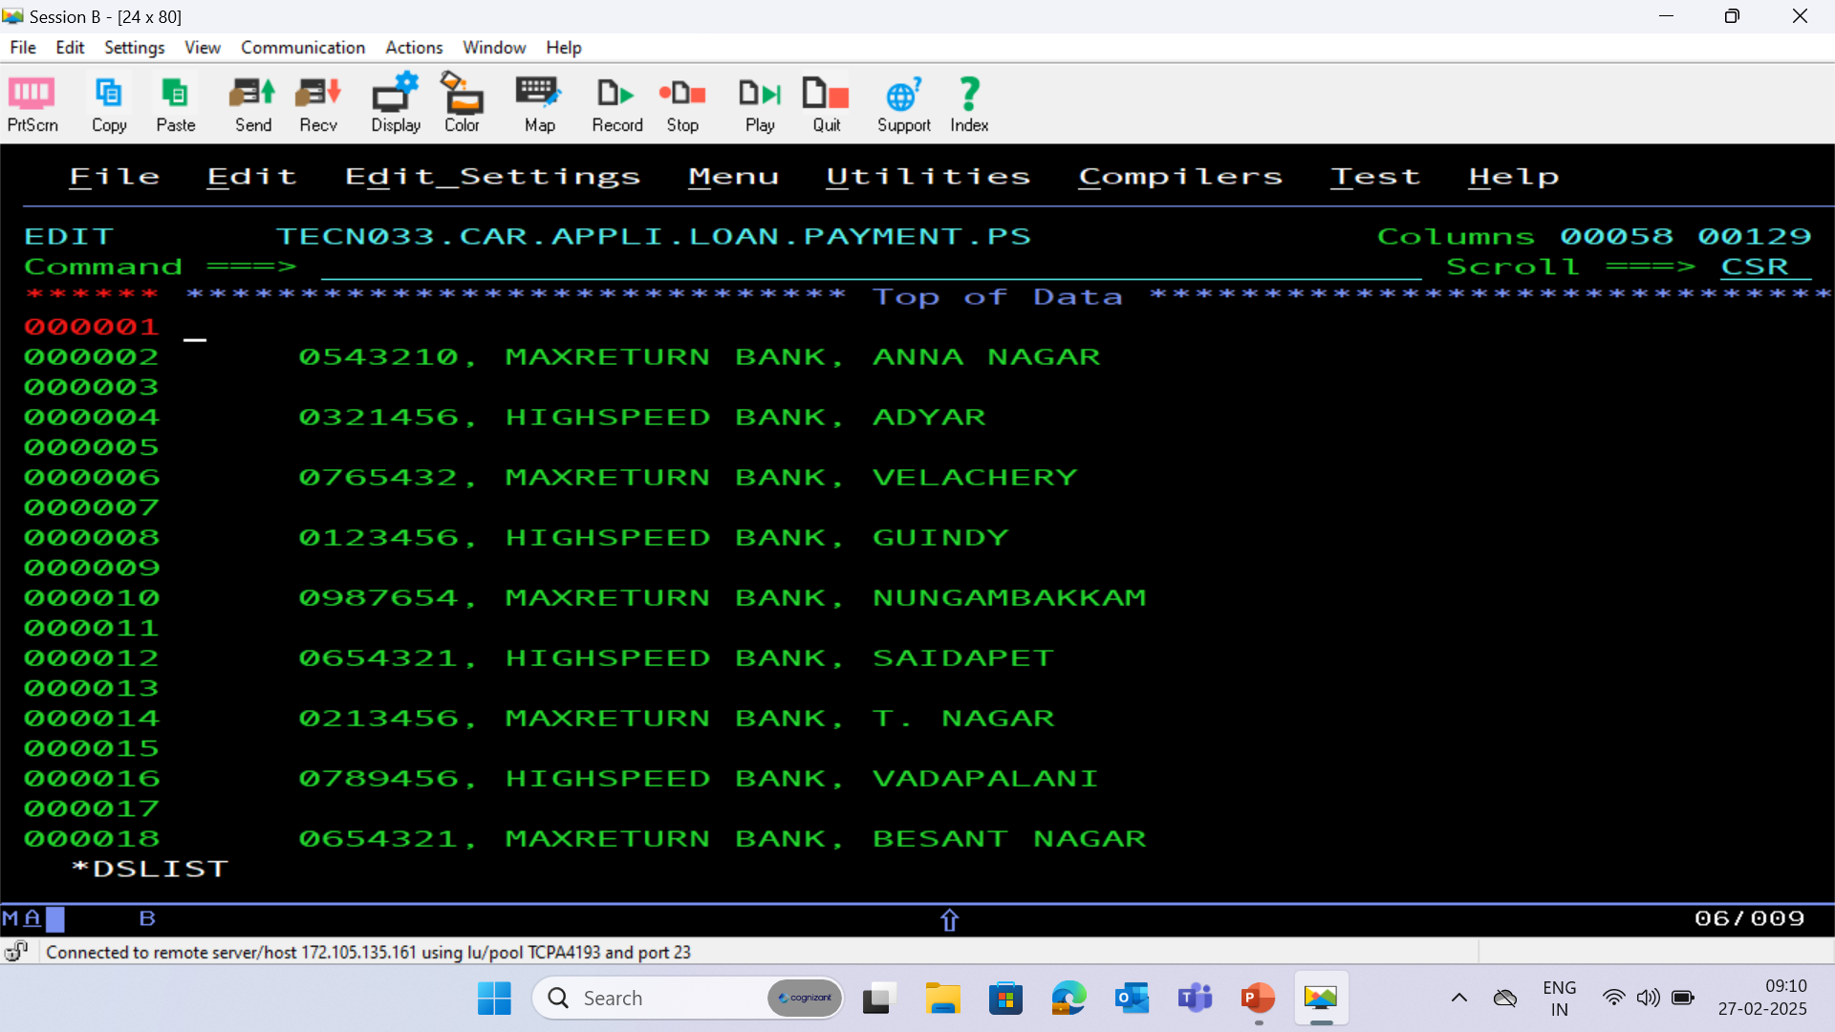

Slide 32
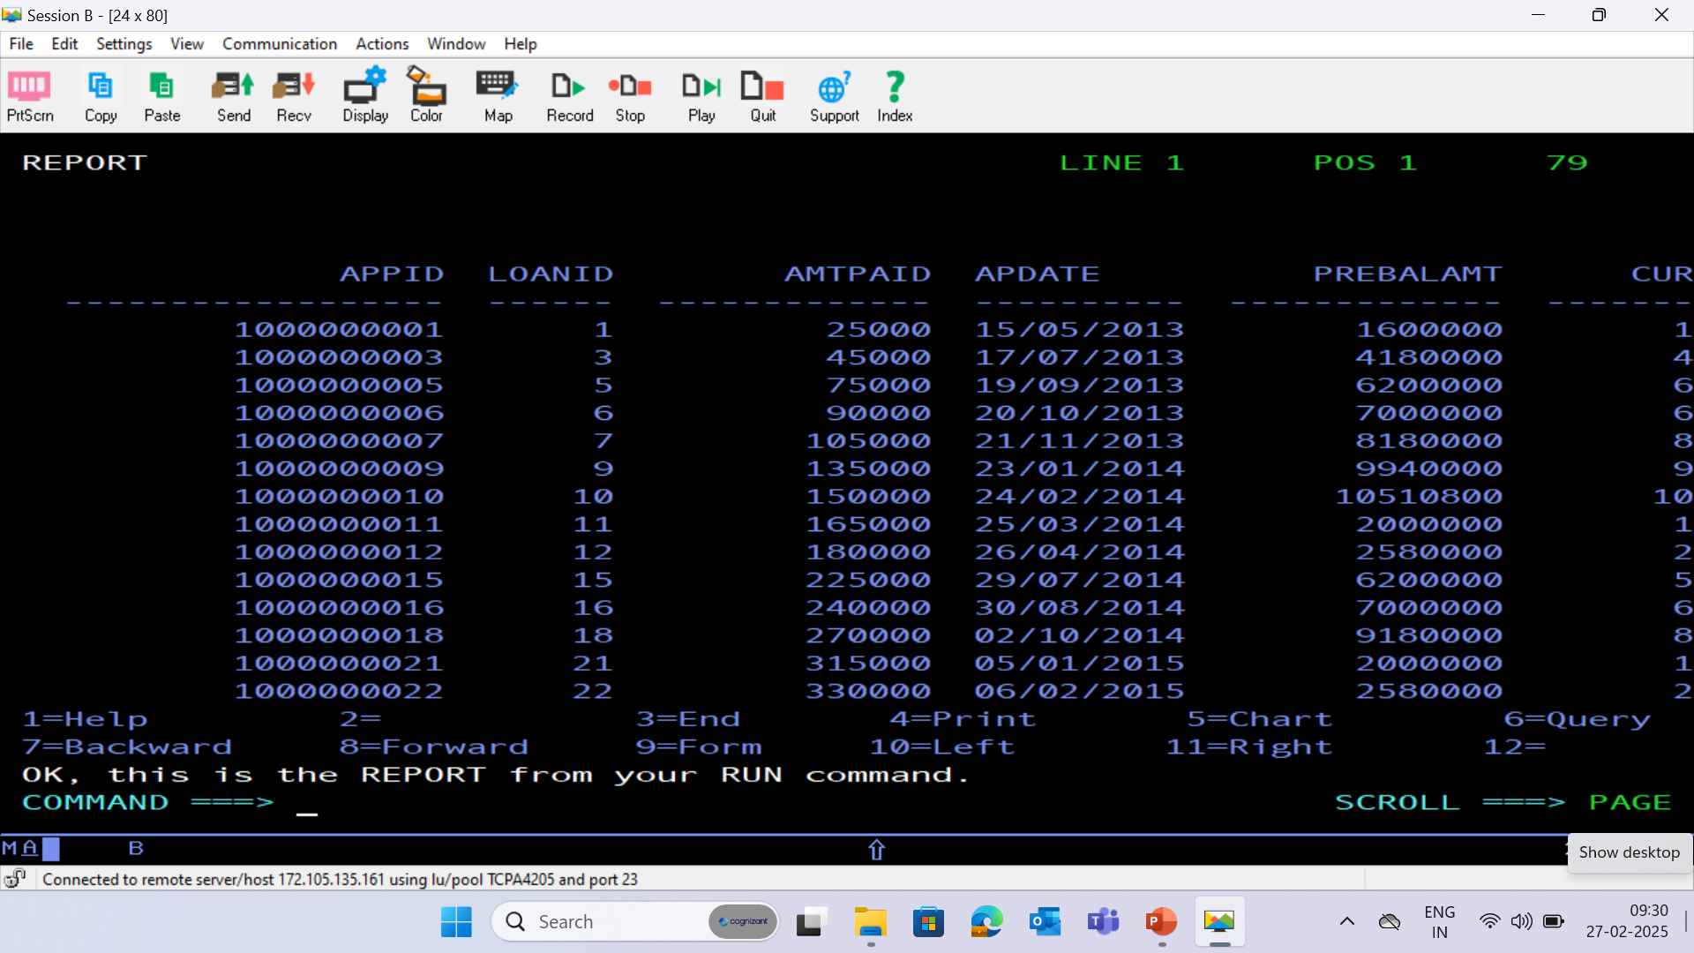
PAYMENT DATABASE - (PAYMENT)

Slide 33
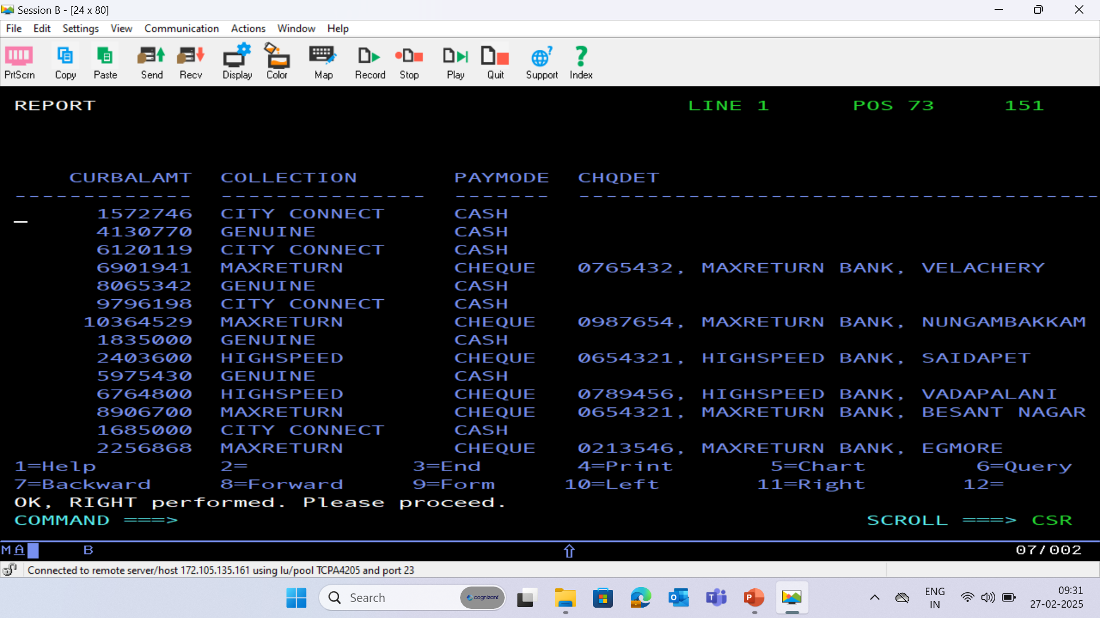

Slide 34
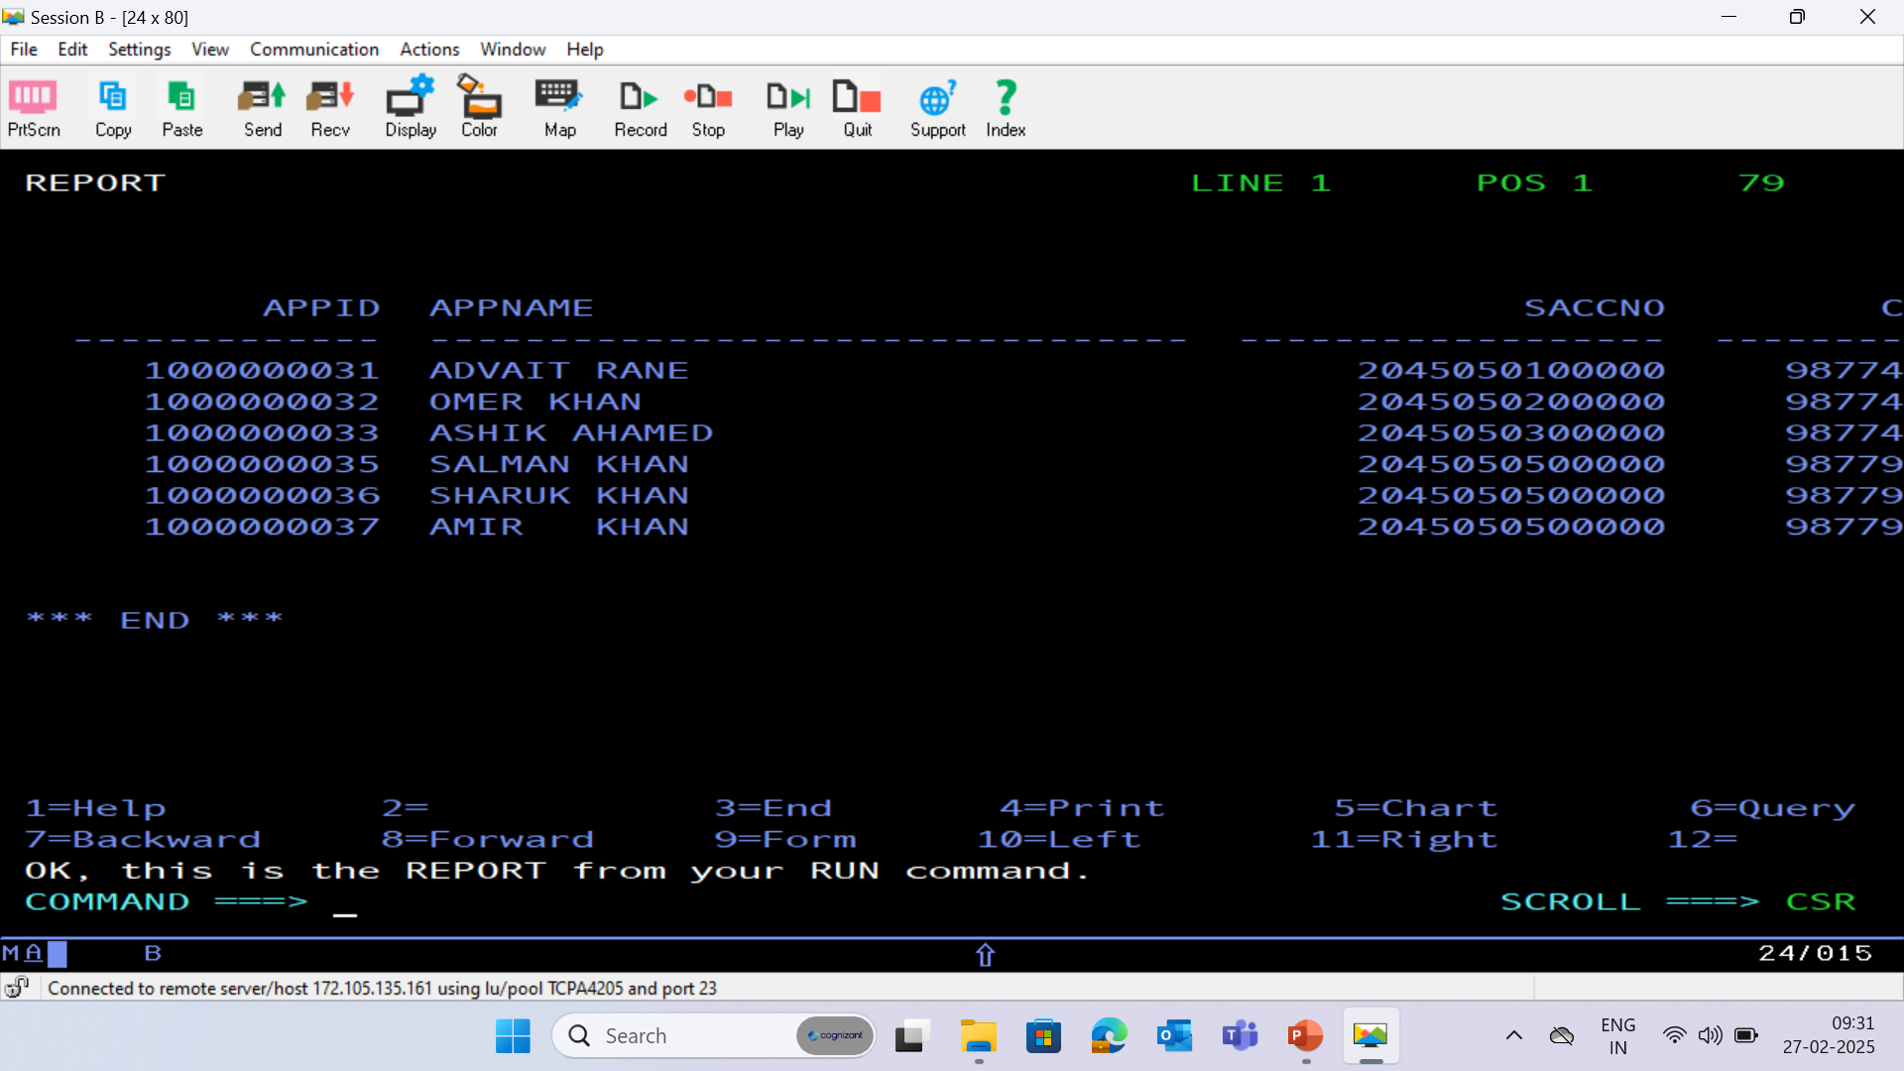
HISTORY DATABASE - (HISTORY)

Slide 35
